Slide 1
Is Ignorance Bliss? Sealed versus Open Auctions in Online Labor Markets
Hanzhe Zhang, Michigan State University
Joint work with:
Qiang Gao, City University of New York
“Julian” Chenhui Guo, Broad College of Business, Michigan State University
Mingfeng Lin, Georgia Institute of Technology
University at Albany
Monday, October 21, 2024

Slide 2





Slide 3

Auction Format: Open (Bids) Auction
Price
Workers
Should I bid now?
How much should I bid?
Bidders
Pitches

Slide 4
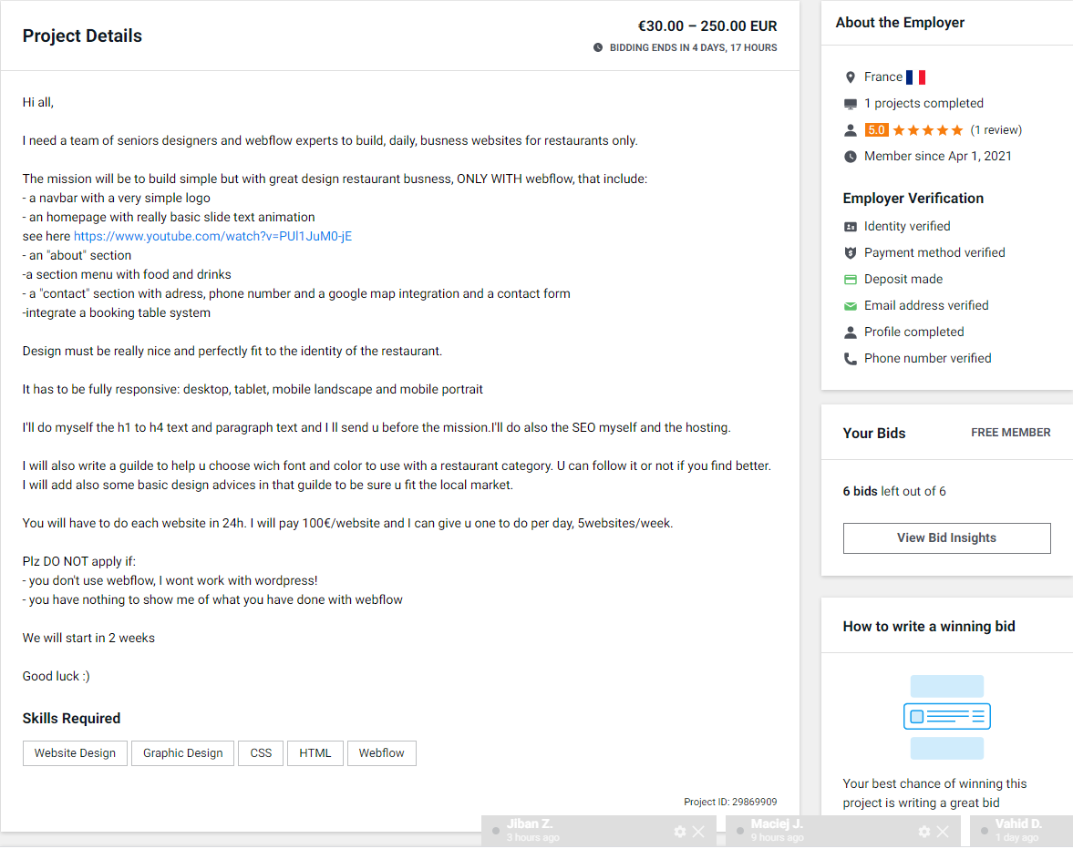
Auction Format: Sealed (Bids) Auction
No Bidding Price
Workers
Should I bid now?
How much should I bid?
No Bidder Info
No Pitches

Slide 5
Empirical/Experimental Comparison
Sealed auctions generate higher revenue
Athey, Levin, and Seira (2011)
Sealed auctions attract weaker sellers to make the auction competitive
Haruvy and Katok (2013)
Sealed auctions reduce collusion opportunities
Sealed auctions generate lower revenue
Shachat and Wei (2012)
Lack of information in sealed auctions may lead to lower bids.
Cho, Paarsch, and Rust (2014)
More information disclosure leads to higher revenue (linkage principle).

Slide 6
Auction Formats in Online Labor Markets
Hong, Wang, and Pavlou (2016): Employers (endogenously) decide whether they will use an open versus sealed format
Sealed format attracts more bids
Bidders bid lower wage amount in open format than in sealed format, leading to higher buyer surplus
Open format is superior for buyers

Slide 7
Natural Experiment
The platform originally operated under an open auction format but transitioned abruptly to a sealed auction format without prior notice to participants.
This format-switching event serves as a natural experiment to assess the impact of auction formats while keeping other platform operations consistent.
Data was collected on all auctions and their bids for three months before and after the regime change.
The dataset includes:
1,926 auctions launched by 967 buyers.
16,581 bids placed by 3,421 sellers.
802 auctions were contracted.

Slide 8
Data and Variables
Policy Date
Three months within Policy Date
Auction and post-auction information:
AfterChange
BidArrival, #OfBidders, Contracted, WinningBid, TimeToAccept
RatingByBuyer, Rehire
Buyer information
BuyerExperience
Region (dummies)
Project Information
DescriptionLength, MaxBid, AuctionDuration
ProjectType (dummies)
Seller information
#OfRatings, NoRating
SellerExperience
Bid Information
BidAmount, BidDelay
BidOrder
SameCountry

Slide 9
Variable | Description | N | Mean | S.D. | Min | Max
AfterChange | A dummy variable that equals one if the project was posted after the regime change day | 1,926 | 0.750 | 0.433 | 0 | 1
BidderArrival | Logged number of bidders placing bids per hour (bid arrival rate) for a project | 1,926 | -2.721 | 1.985 | -8.921 | 3.313
#OfBidders | Logged number of bidders for a project | 1,926 | 1.872 | 0.860 | 0.693 | 4.860
NewSellerRatio | The ratio of new sellers to total sellers within 12 hours of project posting for a project | 1,926 | 0.516 | 0.378 | 0 | 1
Contracted | A dummy variable that equals one if the buyer chose a seller for a posted project | 1,926 | 0.416 | 0.493 | 0 | 1
WinningBid | Logged winning bid for a project | 1,926 | 1.643 | 2.098 | 0 | 8.140
TimeToAccept | Logged number of hours the buyer took to make decision on accepting a bid after posting the project | 802 | 3.317 | 1.843 | 0.036 | 8.929
Rating | A rating given by the buyer who created the job to the hired seller after this seller finishes job | 802 | 8.415 | 3.461 | 0 | 10
Rehire | An indicator that equals 1 if the same buyer who hired current seller hired the seller again in the future | 802 | 0.269 | 0.444 | 0 | 1
BuyerExperience | Logged number of projects the focal buyer has completed at the time of posting current project | 1,926 | 0.342 | 0.738 | 0 | 3.584
Region | A set of dummy variables to show the regions where the buyer comes from
ProjectDescription | Logged length of a project description (i.e., total words). | 1,926 | 3.897 | 1.132 | 0 | 6.094
MaxBid | Logged max bid a buyer would like to accept. | 1,926 | 1.754 | 2.371 | 0 | 11.51
AuctionDuration | Logged number of days a project remained active on the studied platform. | 1,926 | 1.713 | 1.256 | 0 | 4.533
ProjectType | A group of dummy variables for the type of projects
#OfRatings | Logged number of ratings a seller has at the time of current bid | 16,581 | 0.219 | 0.578 | 0 | 3.761
NoRating | An indicator that equals 1 if the seller is a new seller when this seller bid on the current project | 16,581 | 0.743 | 0.437 | 0 | 1
SellerExperience | Logged number of projects the seller has completed at the time of current bid | 16,581 | 0.329 | 0.656 | 0 | 3.892
BidAmount | Logged amount the seller bids for a project | 16,581 | 4.887 | 1.592 | 1.099 | 18.42
BidDelay | Logged time differences in hours between posting project and biding | 16,581 | 3.148 | 1.867 | 0 | 10.73
BidOrder | Logged sequence order of the current bid among all bids for a project | 16,581 | 11.55 | 13.38 | 1 | 139
SameCountry | An indicator that equals to 1 if the seller and buyer come from the same country | 16,581 | 0.201 | 0.401 | 0 | 1

Slide 10
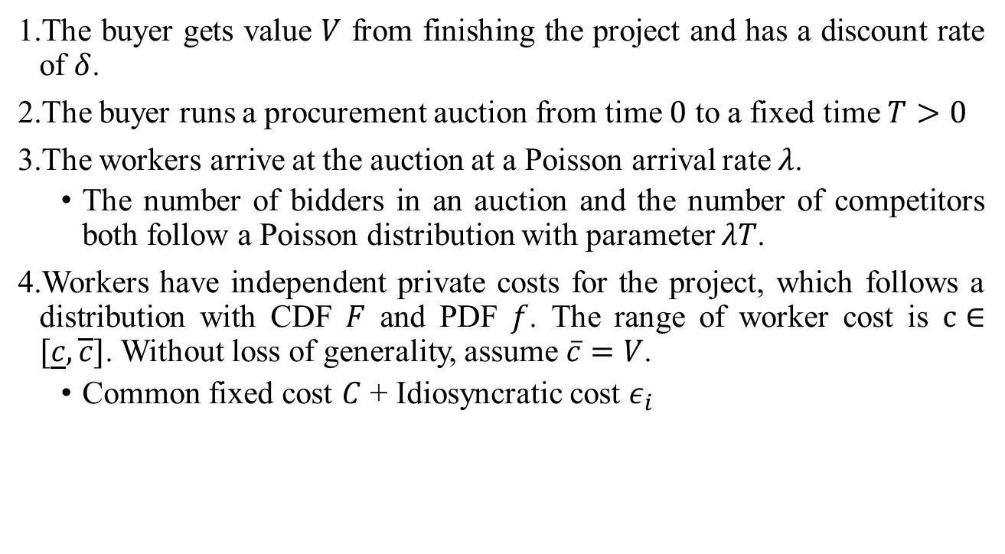
A Simple Economic Model
The buyer gets value $V$ from finishing the project and has a discount rate of $δ$.
The buyer runs a procurement auction from time $0$ to a fixed time $T>0$
The workers arrive at the auction at a Poisson arrival rate $λ$.
The number of bidders in an auction and the number of competitors both follow a Poisson distribution with parameter $λT$.
Workers have independent private costs for the project, which follows a distribution with CDF $F$ and PDF $f$. The range of worker cost is $c∈[\underline{c},\overline{c}]$. Without loss of generality, assume $\overline{c}=V$.
Common fixed cost $C$ + Idiosyncratic cost $ε_{i}$

Slide 11

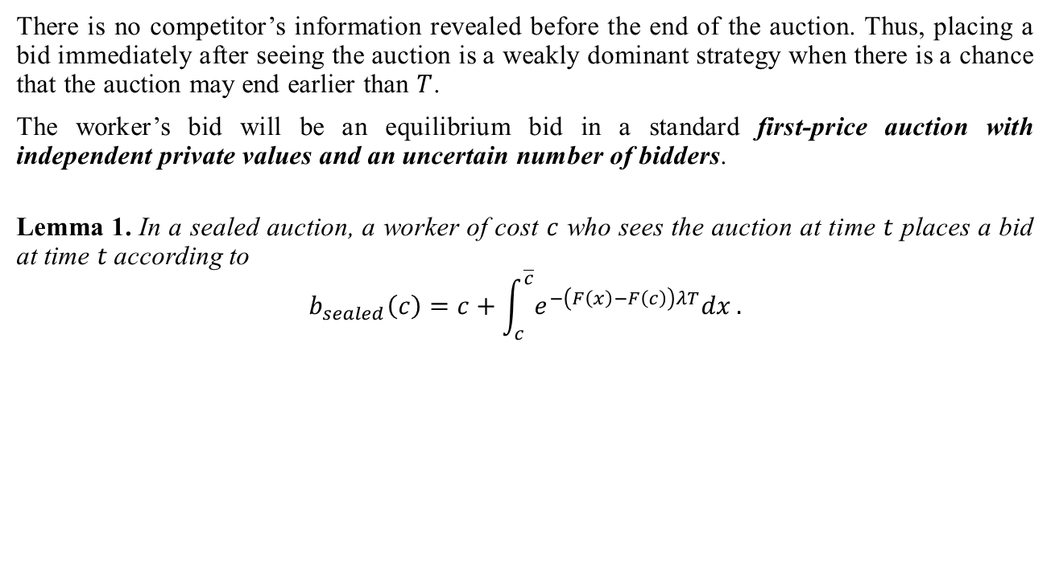
Bidding in a Sealed Auction
There is no competitor’s information revealed before the end of the auction. Thus, placing a bid immediately after seeing the auction is a weakly dominant strategy when there is a chance that the auction may end earlier than $T$.
The worker’s bid will be an equilibrium bid in a standard first-price auction with independent private values and an uncertain number of bidders.
Lemma 1. In a sealed auction, a worker of cost $c$ who sees the auction at time $t$ places a bid at time $t$according to
$$b_{sealed}\left(c\right)=c+\int_{c}^{\overline{c}}{e^{−\left(F\left(x\right)−F\left(c\right)\right)λT}dx}.$$
In general, the bidding function is strictly decreasing in auction time length $T$.
When $T→0$, $b\left(c\right)→\overline{c}$; when $T→∞$, $b\left(c\right)→c$.

Slide 12
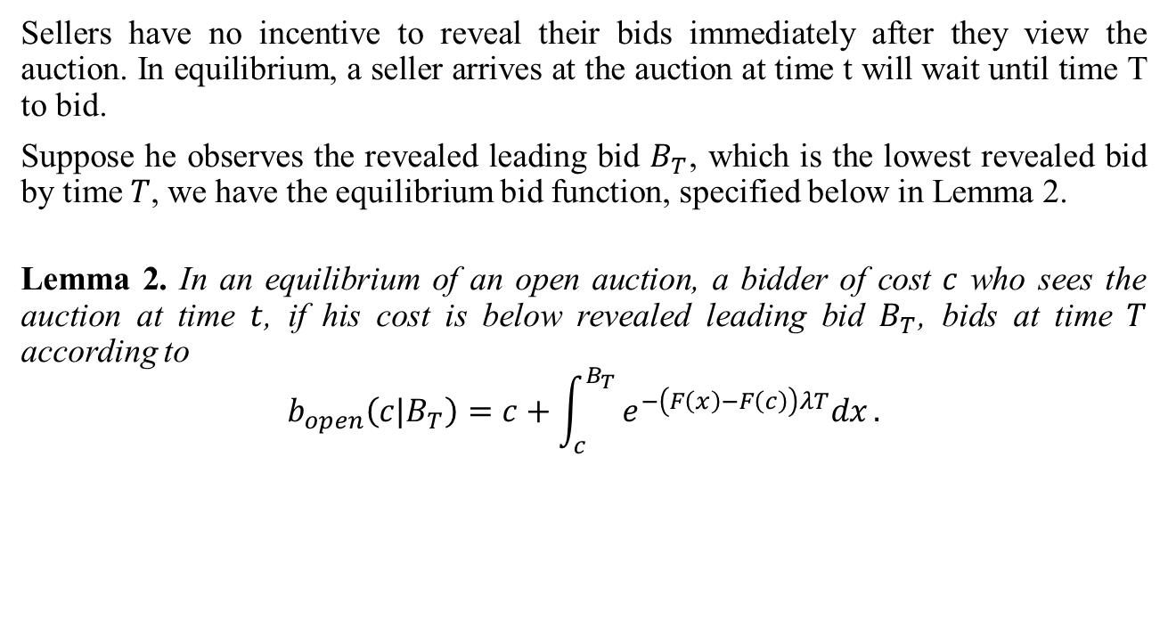
Bidding in an Open Auction
Sellers have no incentive to reveal their bids immediately after they view the auction. In equilibrium, a seller arrives at the auction at time t will wait until time T to bid.
Suppose he observes the revealed leading bid $B_{T}$, which is the lowest revealed bid by time $T$, we have the equilibrium bid function, specified below in Lemma 2.
Lemma 2. In an equilibrium of an open auction, a bidder of cost $c$ who sees the auction at time $t$, if his cost is below revealed leading bid $B_{T}$, bids at time $T$ according to
$$b_{open}\left(c|B_{T}\right)=c+\int_{c}^{B_{T}}{e^{−\left(F\left(x\right)−F\left(c\right)\right)λT}dx}.$$

Slide 13
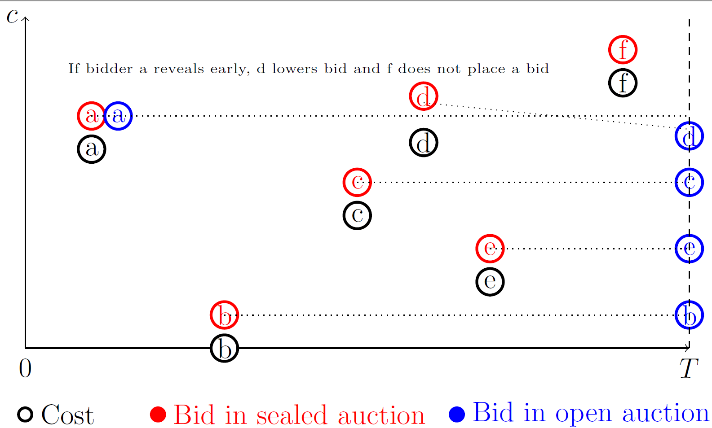

Slide 14
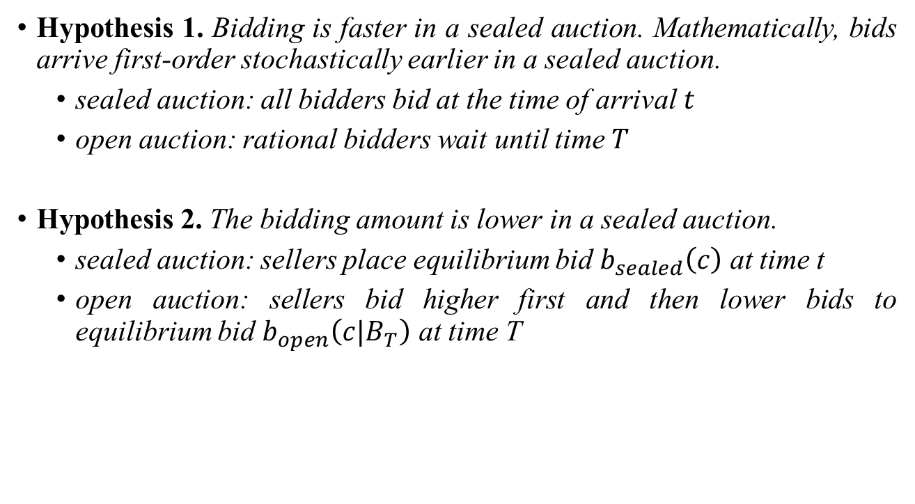
Hypotheses: Bidding Behaviors
Hypothesis 1. Bidding is faster in a sealed auction. Mathematically, bids arrive first-order stochastically earlier in a sealed auction.
sealed auction: all bidders bid at the time of arrival $t$
open auction: rational bidders wait until time $T$
Hypothesis 2. The bidding amount is lower in a sealed auction.
sealed auction: sellers place equilibrium bid $b_{sealed}\left(c\right)$ at time t
open auction: sellers bid higher first and then lower bids to equilibrium bid $b_{open}\left(c|B_{T}\right)$ at time T

Slide 15
Impact on Bidding Behaviors
BidDelay
BidAmount
Variable | Description | N | Mean | S.D. | Min | Max
BidDelay | Logged time differences in hours between posting project and bidding | 16,581 | 3.148 | 1.867 | 0 | 10.73
BidAmount | Logged amount the seller bids for a project | 16,581 | 4.887 | 1.592 | 1.099 | 18.42

Slide 16
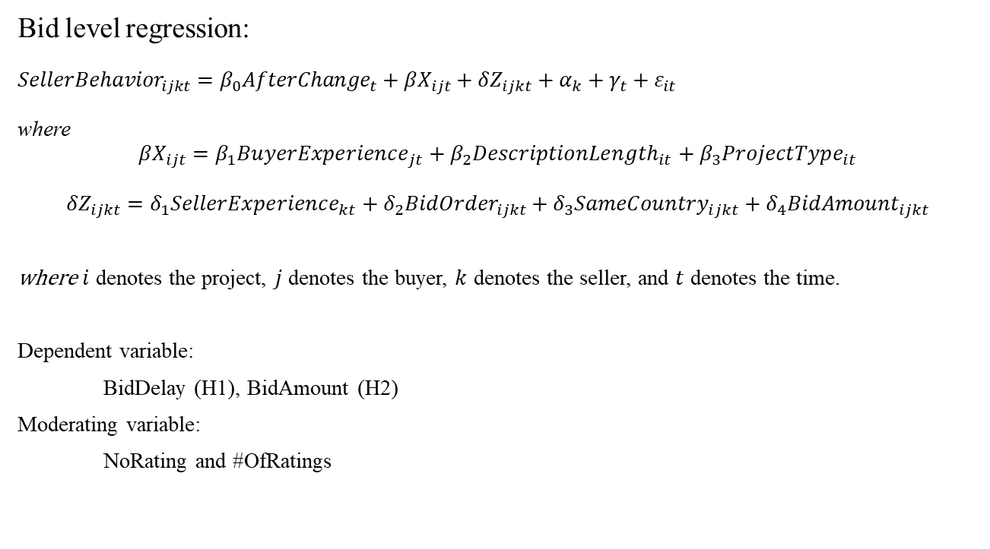
Impact on Bidding Behaviors: Regression
Bid level regression:
$${SellerBehavior}_{ijkt}=β_{0}{AfterChange}_{t}+βX_{ijt}+δZ_{ijkt}+α_{k}+γ_{t}+ε_{it}$$
where
$$βX_{ijt}=β_{1}{BuyerExperience}_{jt}+β_{2}{DescriptionLength}_{it}+β_{3}{ProjectType}_{it}$$
$$δZ_{ijkt}=δ_{1}{SellerExperience}_{kt}+δ_{2}{BidOrder}_{ijkt}+δ_{3}{SameCountry}_{ijkt}+δ_{4}{BidAmount}_{ijkt}$$
where $i$ denotes the project, $j$ denotes the buyer, $k$ denotes the seller, and $t$ denotes the time.
Dependent variable:
BidDelay (H1), BidAmount (H2)
Moderating variable:
NoRating and #OfRatings
Variable | Description | N | Mean | S.D. | Min | Max
#OfRatings | Logged number of ratings a seller has at the time of current bid | 16,581 | 0.219 | 0.578 | 0 | 3.761
NoRating | An indicator that equals 1 if the seller is a new seller when this seller bid on the current project | 16,581 | 0.743 | 0.437 | 0 | 1

Slide 17
Effects of Auction Format Change on Bidding Behaviors
Dep. Variable | Bid Delay (Hypothesis 1) |  |  | Bid Amount (Hypothesis 2)
AfterChange | -0.531*** | -0.231* | -0.578*** | -0.180*** | -0.035 | -0.238***
 | (0.063) | (0.100) | (0.064) | (0.054) | (0.105) | (0.051)
NoRating |  | 0.531*** |  |  | 0.124
 |  | (0.110) |  |  | (0.100)
AfterChange×NoRating |  | -0.395*** |  |  | -0.191+
 |  | (0.115) |  |  | (0.115)
#OfRatings |  |  | 0.047 |  |  | -0.239*
 |  |  | (0.140) |  |  | (0.115)
AfterChange×#OfRatings |  |  | 0.273*** |  |  | 0.329***
 |  |  | (0.081) |  |  | (0.069)
DescriptionLength | -0.036** | -0.035** | -0.036** | 0.093*** | 0.094*** | 0.093***
 | (0.011) | (0.011) | (0.011) | (0.012) | (0.012) | (0.012)
BuyerExperience | -0.092*** | -0.090*** | -0.090*** | -0.143*** | -0.143*** | -0.141***
 | (0.016) | (0.016) | (0.016) | (0.018) | (0.018) | (0.018)
SellerExperience | -0.072 | -0.009 | -0.327** | 0.220*** | 0.188** | 0.156+
 | (0.051) | (0.065) | (0.100) | (0.046) | (0.067) | (0.089)
BidOrder | 0.065*** | 0.065*** | 0.065*** | 0.001 | 0.001 | 0.001
 | (0.002) | (0.002) | (0.002) | (0.001) | (0.001) | (0.001)
SameCountry | 0.002 | 0.001 | 0.004 | -0.145*** | -0.146*** | -0.145***
 | (0.035) | (0.035) | (0.035) | (0.035) | (0.035) | (0.035)
BidAmount | 0.124*** | 0.123*** | 0.122***
 | (0.010) | (0.010) | (0.010)
Observations | 16,581 | 16,581 | 16,581 | 16,581 | 16,581 | 16,581
Number of Sellers | 3,421 | 3,421 | 3,421 | 3,421 | 3,421 | 3,421
Adjusted R-squared | 0.277 | 0.279 | 0.279 | 0.065 | 0.065 | 0.067
Seller Fixed Effects | YES | YES | YES | YES | YES | YES
Weekday Fixed Effects | YES | YES | YES | YES | YES | YES
Project Type Fixed Effects | YES | YES | YES | YES | YES | YES
Note: Robust standard errors in parentheses. *** p<0.001, ** p<0.01, * p<0.05, +p<0.1
Variable | Description | N | Mean | S.D. | Min | Max
#OfRatings | Logged number of ratings a seller has at the time of current bid | 16,581 | 0.219 | 0.578 | 0 | 3.761
NoRating | An indicator that equals 1 if the seller is a new seller when this seller bid on the current project | 16,581 | 0.743 | 0.437 | 0 | 1

Slide 18
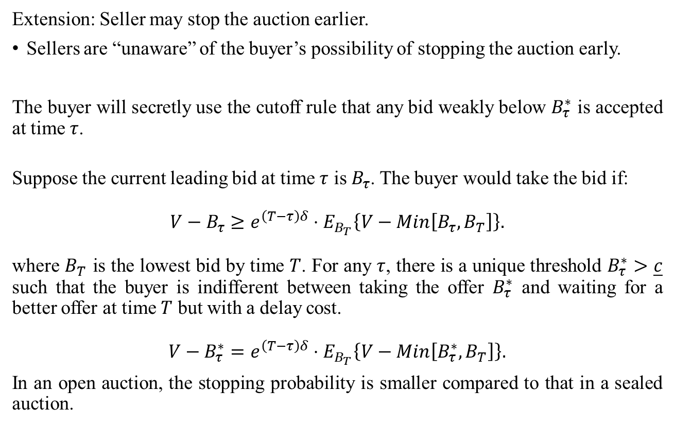
Buyer’s Optimal Stopping
Extension: Seller may stop the auction earlier.
Sellers are “unaware” of the buyer’s possibility of stopping the auction early.
The buyer will secretly use the cutoff rule that any bid weakly below $B_{τ}^{∗}$ is accepted at time $τ$.
Suppose the current leading bid at time $τ$ is $B_{τ}$. The buyer would take the bid if:
$$V−B_{τ}≥e^{\left(T−τ\right)δ}⋅E_{B_{T}}\left\{V−Min\left[B_{τ},B_{T}\right]\right\}.$$
where $B_{T}$ is the lowest bid by time $T$. For any $τ$, there is a unique threshold $B_{τ}^{∗}>\underline{c}$ such that the buyer is indifferent between taking the offer $B_{τ}^{∗}$ and waiting for a better offer at time $T$ but with a delay cost.
$$V−B_{τ}^{∗}=e^{\left(T−τ\right)δ}⋅E_{B_{T}}\left\{V−Min\left[B_{τ}^{∗},B_{T}\right]\right\}.$$
In an open auction, the stopping probability is smaller compared to that in a sealed auction.

Slide 19
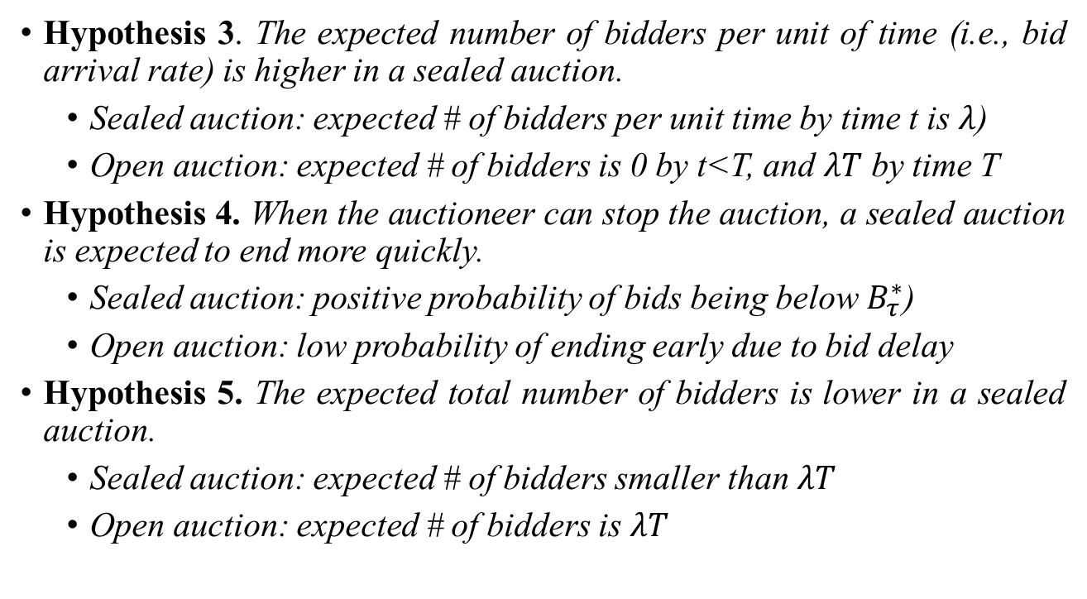
Hypotheses: Bidder Outcomes
Hypothesis 3. The expected number of bidders per unit of time (i.e., bid arrival rate) is higher in a sealed auction.
Sealed auction: expected # of bidders per unit time by time t is $λ$)
Open auction: expected # of bidders is 0 by t<T, and $λT$ by time T
Hypothesis 4. When the auctioneer can stop the auction, a sealed auction is expected to end more quickly.
Sealed auction: positive probability of bids being below $B_{τ}^{∗}$)
Open auction: low probability of ending early due to bid delay
Hypothesis 5. The expected total number of bidders is lower in a sealed auction.
Sealed auction: expected # of bidders smaller than $λT$
Open auction: expected # of bidders is $λT$

Slide 20
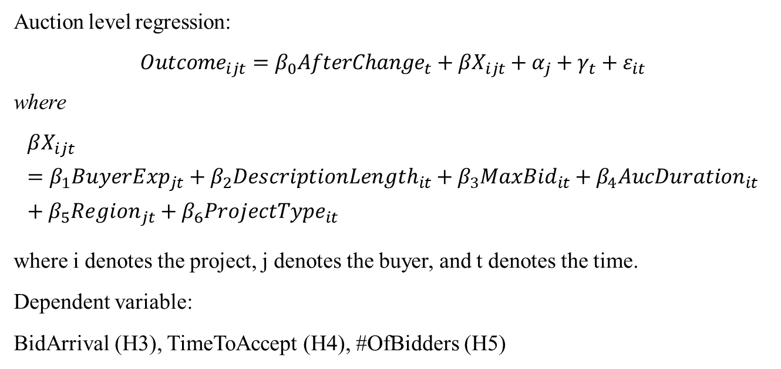
Impact on Bidder Outcomes: Regression
Auction level regression:
$${Outcome}_{ijt}=β_{0}{AfterChange}_{t}+βX_{ijt}+α_{j}+γ_{t}+ε_{it}$$
where
$$βX_{ijt}=β_{1}{BuyerExp}_{jt}+β_{2}{DescriptionLength}_{it}+β_{3}{MaxBid}_{it}+β_{4}{AucDuration}_{it}+β_{5}{Region}_{jt}+β_{6}{ProjectType}_{it}$$
where i denotes the project, j denotes the buyer, and t denotes the time.
Dependent variable:
BidArrival (H3), TimeToAccept (H4), #OfBidders (H5)
Variable | Description | N | Mean | S.D. | Min | Max
BidderArrival | Logged number of bidders placing bids per hour (bid arrival rate) for a project | 1,926 | -2.721 | 1.985 | -8.921 | 3.313
TimeToAccept | Logged number of hours the buyer took to make decision on accepting a bid after posting the project | 802 | 3.317 | 1.843 | 0.036 | 8.929
#OfBidders | Logged number of bidders for a project | 1,926 | 1.872 | 0.860 | 0.693 | 4.860

Slide 21
Effects of Auction Format Change on Bidder Outcomes
Dep. Variable | Bid Arrival Rate (Hypothesis 3) |  | Time to Accept (Hypothesis 4) |  | Number of Bidders (Hypothesis 5)
 | RE | OLS | RE | OLS | RE | OLS
AfterChange | 0.337*** | 0.337*** | -0.493** | -0.521*** | -0.109* | -0.150***
 | (0.094) | (0.084) | (0.163) | (0.138) | (0.047) | (0.043)
DescriptionLength | 0.024 | 0.024 | 0.145** | 0.138** | 0.142*** | 0.128***
 | (0.043) | (0.038) | (0.050) | (0.049) | (0.018) | (0.016)
BuyerExperience | 0.469*** | 0.469*** | -0.354*** | -0.552*** | -0.144*** | -0.126***
 | (0.061) | (0.069) | (0.080) | (0.079) | (0.039) | (0.027)
MaxBid | 0.060*** | 0.060*** | -0.049+ | -0.054* | -0.013 | -0.011
 | (0.017) | (0.017) | (0.025) | (0.026) | (0.009) | (0.008)
AuctionDuration | -1.154*** | -1.154*** | 1.115*** | 1.074*** | 0.130*** | 0.129***
 | (0.049) | (0.051) | (0.095) | (0.100) | (0.028) | (0.028)
Observations | 1,926 | 1,926 | 802 | 802 | 1,926 | 1,926
Adjusted R² | 0.254 | 0.254 | 0.306 | 0.314 | 0.145 | 0.149
Number of Buyers | 967 | 967 | 423 | 423 | 967 | 967
Buyer Region Dummies | YES | YES | YES | YES | YES | YES
Weekday Dummies | YES | YES | YES | YES | YES | YES
Project Type Fixed Effects | YES | YES | YES | YES | YES | YES
Note: Robust standard errors in parentheses. *** p<0.001, ** p<0.01, * p<0.05, +p<0.1
Variable | Description | N | Mean | S.D. | Min | Max
BidderArrival | Logged number of bidders placing bids per hour (bid arrival rate) for a project | 1,926 | -2.721 | 1.985 | -8.921 | 3.313
TimeToAccept | Logged number of hours the buyer took to make decision on accepting a bid after posting the project | 802 | 3.317 | 1.843 | 0.036 | 8.929
#OfBidders | Logged number of bidders for a project | 1,926 | 1.872 | 0.860 | 0.693 | 4.860

Slide 22
Hypotheses: Project Outcomes
Hypothesis 6. Buyers are more likely to successfully hire a seller in a sealed auction.
Sealed auction: buyer has more choices given more bids
Open auction: impatient buyer may choose to stop the auction without hiring
Hypothesis 7. Buyers are more likely to hire a seller with a lower wage (i.e., winning bid) in a sealed auction.
Sealed auction
buyer has more choices and bids may be lower
but impatient buyer may choose to hire a seller with a higher wage (i.e., to accept a bid too early)

Slide 23
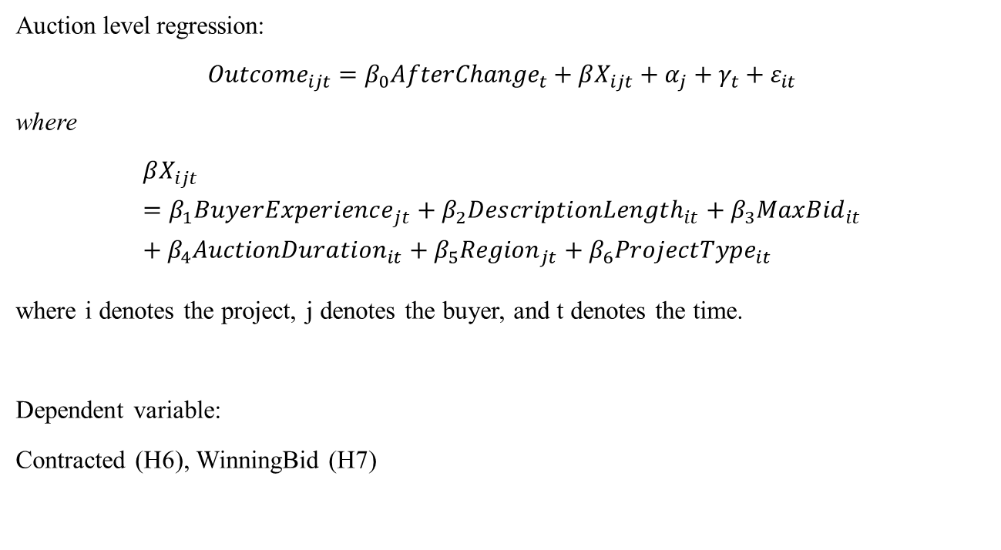
Impact on Project Outcomes: Regression
Auction level regression:
$${Outcome}_{ijt}=β_{0}{AfterChange}_{t}+βX_{ijt}+α_{j}+γ_{t}+ε_{it}$$
where
$$βX_{ijt}=β_{1}{BuyerExperience}_{jt}+β_{2}{DescriptionLength}_{it}+β_{3}{MaxBid}_{it}+β_{4}{AuctionDuration}_{it}+β_{5}{Region}_{jt}+β_{6}{ProjectType}_{it}$$
where i denotes the project, j denotes the buyer, and t denotes the time.
Dependent variable:
Contracted (H6), WinningBid (H7)
Variable | Description | N | Mean | S.D. | Min | Max
Contracted | A dummy variable that equals one if the buyer chose a seller for a posted project | 1,926 | 0.416 | 0.493 | 0 | 1
WinningBid | Logged winning bid for a project | 1,926 | 1.643 | 2.098 | 0 | 8.140

Slide 24
Effects of Auction Format Change on Project Outcomes
Dep. Variable | Auction Success (Contracted) (Hypothesis 6) |  | Winning Amount (Hypothesis 7)
 | RE | OLS | RE | OLS
AfterChange | 0.061* | 0.066** | -0.053 | 0.080
 | (0.028) | (0.025) | (0.108) | (0.106)
DescriptionLength | 0.017 | 0.012 | 0.030 | 0.049
 | (0.012) | (0.010) | (0.034) | (0.036)
BuyerExperience | 0.068 | 0.066*** | -0.032 | -0.036
 | (0.042) | (0.017) | (0.072) | (0.059)
MaxBid | 0.011* | 0.011* | 0.042* | 0.040*
 | (0.005) | (0.005) | (0.020) | (0.020)
AuctionDuration | -0.124*** | -0.132*** | 0.130+ | 0.253**
 | (0.015) | (0.015) | (0.069) | (0.079)
Observations | 1,926 | 1,926 | 802 | 802
Adjusted R² | 0.091 | 0.092 | 0.063 | 0.089
Number of Buyers | 967 | 967 | 423 | 423
Buyer Region Dummies | YES | YES | YES | YES
Weekday Dummies | YES | YES | YES | YES
Project Type Fixed Effects | YES | YES | YES | YES
Note: Robust standard errors in parentheses. *** p<0.001, ** p<0.01, * p<0.05, +p<0.1
Variable | Description | N | Mean | S.D. | Min | Max
Contracted | A dummy variable that equals one if the buyer chose a seller for a posted project | 1,926 | 0.416 | 0.493 | 0 | 1
WinningBid | Logged winning bid for a project | 1,926 | 1.643 | 2.098 | 0 | 8.140

Slide 25
Hypotheses: Post-Project Outcomes
Hypothesis 8. After the projects are completed, buyers are more likely to be satisfied with the selected sellers’ work in a sealed auction (i.e., after regime change).
Hypothesis 9. After the projects are completed, buyers are more likely to hire the same seller in the future, in a sealed auction (i.e., after the regime change).
Hypothesis 10. After the projects are completed, winning sellers are less likely to exit the online labor market in a sealed auction (i.e., after the regime change).

Slide 26
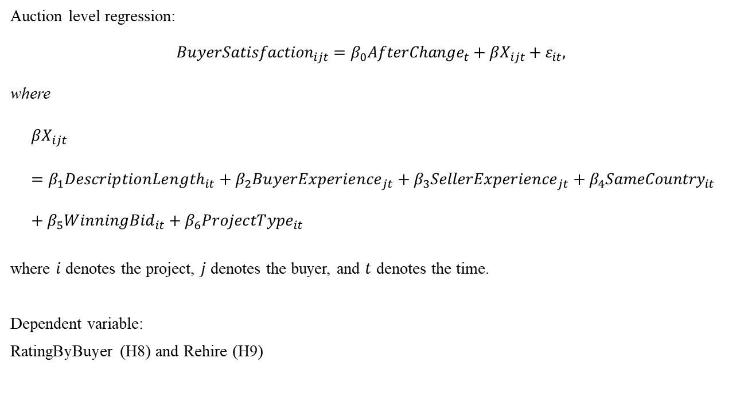
Impact on Post-Project Outcome: Rating and Rehiring
Auction level regression:
$${BuyerSatisfaction}_{ijt}=β_{0}{AfterChange}_{t}+βX_{ijt}+ε_{it},$$
where
$$βX_{ijt}=β_{1}{DescriptionLength}_{it}+β_{2}{BuyerExperience}_{jt}+β_{3}{SellerExperience}_{jt}+β_{4}{SameCountry}_{it}+β_{5}{WinningBid}_{it}+β_{6}{ProjectType}_{it}$$
where $i$ denotes the project, $j$ denotes the buyer, and $t$ denotes the time.
Dependent variable:
RatingByBuyer (H8) and Rehire (H9)
Variable | Description | N | Mean | S.D. | Min | Max
Rating | A rating given by the buyer who created the job to the hired seller after this seller finishes job | 802 | 8.415 | 3.461 | 0 | 10
Rehire | An indicator that equals 1 if the same buyer who hired current seller hired the seller again in the future | 802 | 0.269 | 0.444 | 0 | 1

Slide 27
Effects of Auction Format Change on Buyer Satisfaction
Dep. Variable | DV: Rating by Buyer (Hypothesis 8) |  |  | DV: Rehire (Hypothesis 9)
AfterChange | 0.249*** | 0.245*** | 0.205** | 0.139*** | 0.124*** | 0.0437
 | (0.0858) | (0.0852) | (0.0866) | (0.0353) | (0.0357) | (0.0359)
DescriptionLength |  | 0.00456 | 0.0116 |  | -0.0193 | -0.00370
 |  | (0.0250) | (0.0246) |  | (0.0147) | (0.0126)
BuyerExperience |  |  | 0.0543** |  |  | 0.0986***
 |  |  | (0.0227) |  |  | (0.0179)
SellerExperience |  |  | 0.0526** |  |  | 0.0938***
 |  |  | (0.0239) |  |  | (0.0194)
SameCountry |  |  | 0.0252 |  |  | -0.0370
 |  |  | (0.0605) |  |  | (0.0319)
WinningBid |  | -0.0121 | -0.0160 |  | 0.0179 | 0.00897
 |  | (0.0209) | (0.0215) |  | (0.0147) | (0.0140)
Observations | 802 | 802 | 802 | 802 | 802 | 802
Adjusted R² | 0.019 | 0.025 | 0.029 | 0.015 | 0.027 | 0.091
Project-type Fixed Effects | No | YES | YES | No | YES | YES
Note: Robust standard errors in parentheses. *** p<0.001, ** p<0.01, * p<0.05, +p<0.1
Variable | Description | N | Mean | S.D. | Min | Max
Rating | A rating given by the buyer who created the job to the hired seller after this seller finishes job | 802 | 8.415 | 3.461 | 0 | 10
Rehire | An indicator that equals 1 if the same buyer who hired current seller hired the seller again in the future | 802 | 0.269 | 0.444 | 0 | 1

Slide 28
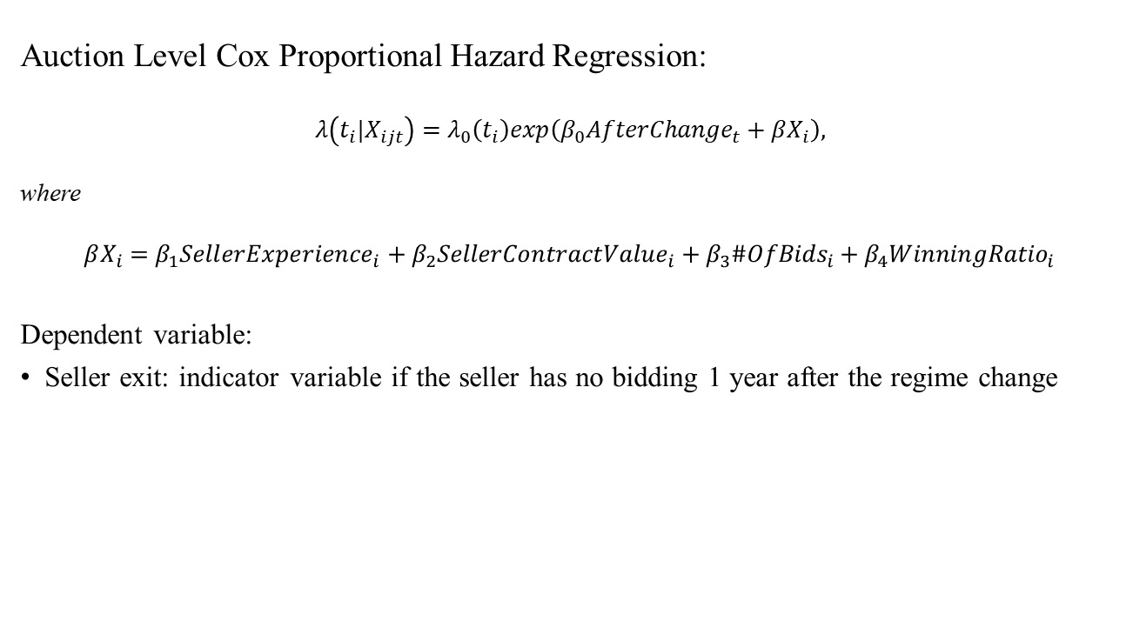
Impact on Post-Project Outcome: Seller Exit
Auction Level Cox Proportional Hazard Regression:
$λ\left(t_{i}|X_{ijt}\right)=λ_{0}\left(t_{i}\right)exp\left(β_{0}{AfterChange}_{t}+βX_{i}\right),$
where
$$βX_{i}=β_{1}{SellerExperience}_{i}+β_{2}{SellerContractValue}_{i}+β_{3}{\#OfBids}_{i}+β_{4}{WinningRatio}_{i}$$
Dependent variable:
Seller exit: indicator variable if the seller has no bidding 1 year after the regime change

Slide 29
Effect of Auction Format Change on Seller Exit
Dep. Variable | DV: Seller Exit (Hypothesis 10)
 | Coefficients | Hazard Ratio
AfterChange | -1.933*** | .145***<1
 | (0.331) | (.048)
SellerExperience | 0.0795 | 1.083
 | (0.111) | (.121)
SellerContractValue | -0.0352 | .965
 | (0.0381) | (.037)
#OfBids | -0.179* | .837*
 | (0.0927) | (.078)
WinningRatio | 0.0603 | 1.062
 | (0.855) | (.909)
Observations | 650
# of failures | 214
Note: Robust standard errors (clustered at the seller level) are in parentheses. *** p<0.01, ** p<0.05, * p<0.1
Seller exit: indicator variable if the seller has no bidding 1 year after the regime change
sellers are 85.5% less likely to leave the market at the one-year cut-off date if they completed the focal project after the auction format change.

Slide 30
Summary of Hypotheses
Category | Dependent Variable (Hypothesis) | Description
Bidder Behavior | BidDelay (H1) | Bidding is faster in a sealed auction than in an open auction. Mathematically, bids arrive first-order stochastically earlier in a sealed auction (i.e., after the regime change) than in an open auction (i.e., before the regime change).
 | BidAmount (H2) | The bidding amount is lower in a sealed auction (i.e., after the regime change) than in an open auction (i.e., before the regime change).
Bidder Outcome | BidArrival (H3) | The expected number of bidders per unit of time (i.e., bid arrival rate) is higher in a sealed auction (i.e., after the regime change) than in an open auction (i.e., before the regime change).
 | TimeToAccept (H4) | When the auctioneer can stop the auction, a sealed auction (i.e., after the regime change) is expected to end more quickly than an open auction (i.e., before the regime change).
 | #OfBidders (H5) | The expected total number of bidders is lower in a sealed auction (i.e., after the regime change) than in an open auction (i.e., before the regime change).
Project Outcome | Contracted (H6) | Buyers are more likely to successfully hire a seller, in a sealed auction (i.e., after the regime change) than in an open auction (i.e., before the regime change).
 | WinningBid (H7) | Buyers are more likely to hire a seller with a lower wage (i.e., winning bid), in a sealed auction (i.e., after the regime change) than in an open auction (i.e., before the regime change).
Post-Project | RatingByBuyer (H8) | After the projects are completed, buyers are more likely to be satisfied with the selected sellers’ work in a sealed auction (i.e., after regime change) than in an open auction (i.e., before regime change).
 | Rehire (H9) | After the projects are completed, buyers are more likely to hire the same seller in the future, in a sealed auction (i.e., after the regime change) than in an open auction (i.e., before the regime change).
 | SellerExit (H10) | After the projects are completed, winning sellers are less likely to exit the online labor market in a sealed auction (i.e., after the regime change) than in an open auction (i.e., before the regime change).

Slide 31
Summary of Key Findings
Category | Dependent Variable (Hypothesis) | Prediction | Result Summary | Supported
Bidding Behavior | BidDelay (H1) | Open > Sealed | 41.2% (FE) shorter delay in bidding | Yes
 | BidAmount (H2) | Open > Sealed | 16.5% (FE) decrease in bid amount | Yes
Bidder Outcome | BidArrival (H3) | Open < Sealed | 40.1% (RE) or 40.1% (OLS) increase | Yes
 | TimeToAccept (H4) | Open > Sealed | 39.0% (RE) or 40.6% (OLS) shorter time | Yes
 | #OfBidders (H5) | Open > Sealed | 10.3% (RE) or 13.9% (OLS) decrease | Yes
Project Outcome | Contracted (H6) | Open < Sealed | 5.6% (RE) or 6.0% (OLS) increase | Yes
 | WinningBid (H7) | Open > Sealed | Insignificant | -
Post-Project | RatingByBuyer (H8) | Open < Sealed | 0.249 increase out of 10 (left truncated at 7) | Yes
 | Rehire (H9) | Open < Sealed | Buyers are 13.9% more likely to rehire | Yes
 | SellerExit (H10) | Open > Sealed | Sellers are 85.5% less likely to exit given a time after the focal project is completed (hazard ratio 0.145) | Yes

Slide 32
Robustness Checks and Additional Analyses
Impact on auction outcomes
Alternative dependent variables: #OfBids and #BidsPerBidder
Alternative estimations:
RE-Logit and RE-Probit for Contracted (H6)
Ordered Logit and Ordered Probit for RatingByBuyer (H8)
Logit and Probit for Rehire (H9)

Slide 33
Conclusion
Regime change: open → sealed auction format
Bidding behaviors
Time taken to decide to bid is reduced
Bidding amount becomes lower (more competitive)
Bidder outcomes
Bidder arrival rate increases
Time taken to accept a bid decreases
# of bidders decreases
Buyer-relevant outcomes
Contract probability increases
Wage amount doesn’t change
Post-project outcomes
Higher buyer satisfaction (rating by buyer increases, rehire probability increases)
Higher seller satisfaction (seller exit decreases)

Slide 34
Thank You!
Qiang Gao, Chenhui Guo, Mingfeng Lin, and Hanzhe Zhang, “Is Ignorance Bliss? Sealed versus Open Auctions in Online Labor Markets,”
Available on SSRN:
https://papers.ssrn.com/sol3/papers.cfm?abstract_id=4929240.
A related working paper using the same context:
Qiang Gao, Mingfeng Lin, Yong Liu, and Chenhui Guo, “When ‘Signals’ Boomerang: Employers’ Reactions to a Novel Signaling Mechanism.”
Available on SSRN:
https://papers.ssrn.com/sol3/papers.cfm?abstract_id=3399245.

Slide 35
Impact on Auction Outcomes
Log(BidArrival)
Log(TimeToAccept)
Log(#OfBidders)
Contracted
Log(WinningBid)

